Slide 1
Pharma Sales Analysis
An Analysis by Nithish Balaji NL

Slide 2
Why This Analysis?
Improve Order Fulfillment – Ensure timely shipping and minimize discrepancies between ordered, shipped, and invoiced quantities.
Improve Operational Efficiency – Optimize warehouse management and shipping methods to reduce costs and delays.
Enhance Customer Experience – Reduce order returns and cancellations by improving accuracy and on-time delivery rates.

Slide 3
Process Overview
Data Collection
Data Cleaning & Preprocessing
Feature Engineering
Visualization & Insights
Business Interpretation & Recommendations

Slide 4
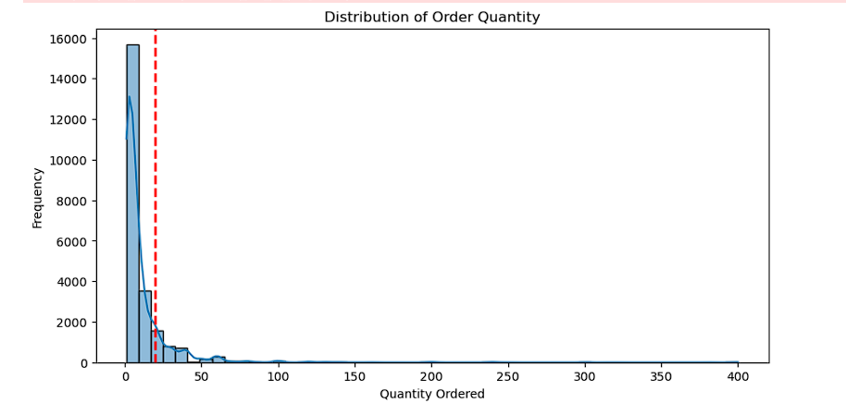
Total Orders Analyzed: 18,232 transactions
Understanding the Data
Data Segmentation:
To better understand order patterns, we divided the data into two categories based on order quantity:
Small Orders (Qty Ordered ≤ 20)
Medium Orders (Qty Ordered ≤100)
Bulk Orders (Qty Ordered > 100)
Total Orders Analysed: 23296
Small Orders : 20668
Medium Orders: 2416
Bulk Orders: 211

Slide 5
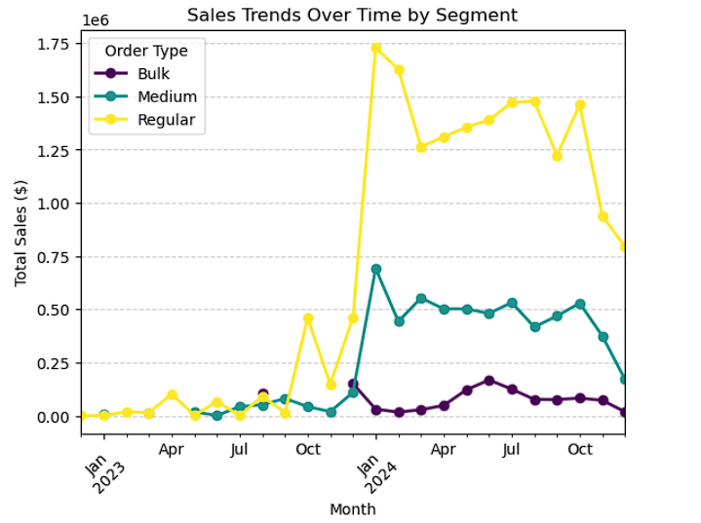
Monthly Sales Trends by Order Type
Regular Orders saw a major spike around Jan 2024, followed by fluctuating but high sales.
Medium Orders experienced steady growth, peaking after the increase in Regular Orders.
Optimize inventory and pricing to sustain the demand surge seen in early 2024.
Introduce volume-based discounts or targeted incentives to boost bulk sales.

Slide 6
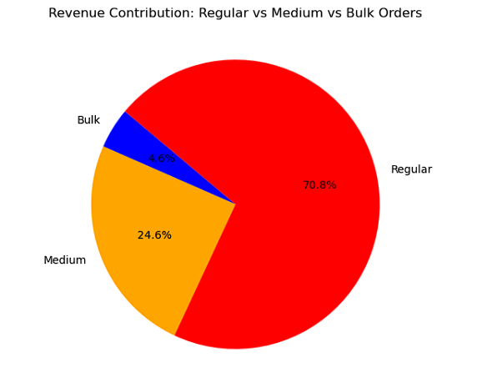
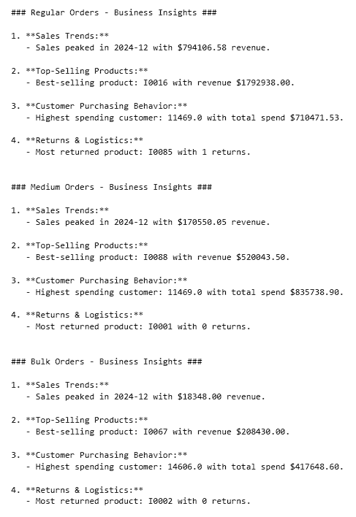
Given that regular orders contribute the most revenue, optimize pricing, promotions, and inventory to sustain growth.
Bulk orders have the lowest revenue contribution. Implement targeted incentives, discounts, or contract-based pricing to encourage larger purchases.

Slide 7
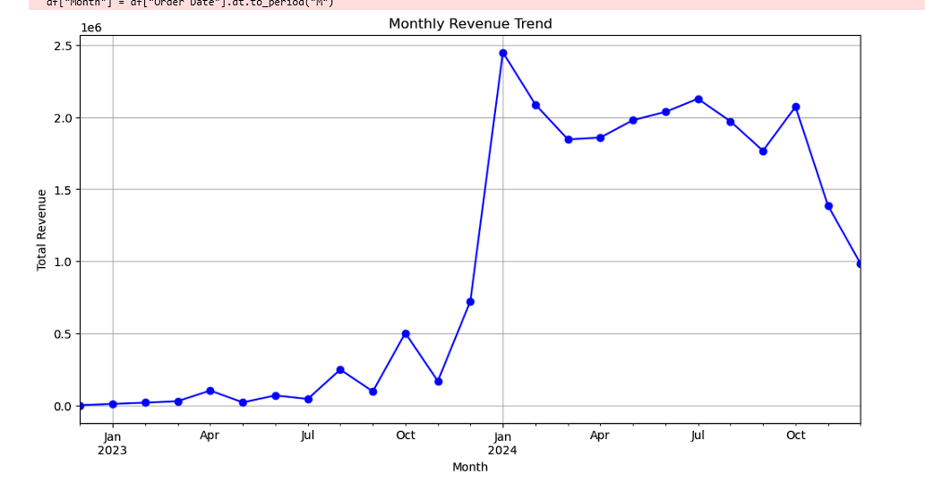
What are the peak sales periods?
Steady growth in 2023, followed by a sharp surge in Jan 2024.
Revenue remained high with fluctuations throughout 2024.
Since sales surged in January 2024, plan marketing campaigns and inventory accordingly to maximize revenue during high-demand periods
Investigate factors causing the drop, such as seasonality or regulatory impacts, and adjust pricing, promotions, or distribution strategies to sustain revenue.

Slide 8
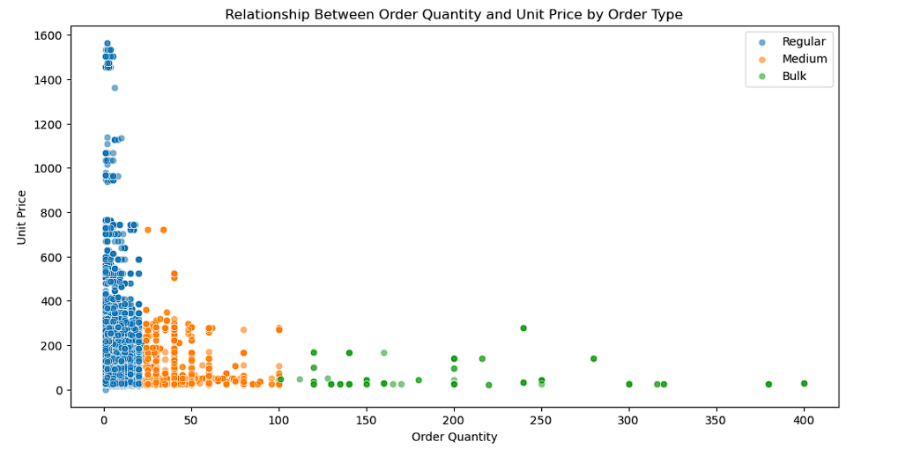
Do lower prices result in higher order quantities?
Bulk orders have the lowest unit prices, confirming volume-based discounts.
Regular orders have higher unit prices, indicating premium or specialty products.
Optimizing pricing tiers and targeted promotions can drive higher sales volume.
Since lower unit prices drive higher order quantities, offer volume-based discounts and loyalty programs to encourage bulk purchases.
Maintain premium pricing but introduce limited-time discounts or bundling to increase sales while preserving margins.

Slide 9
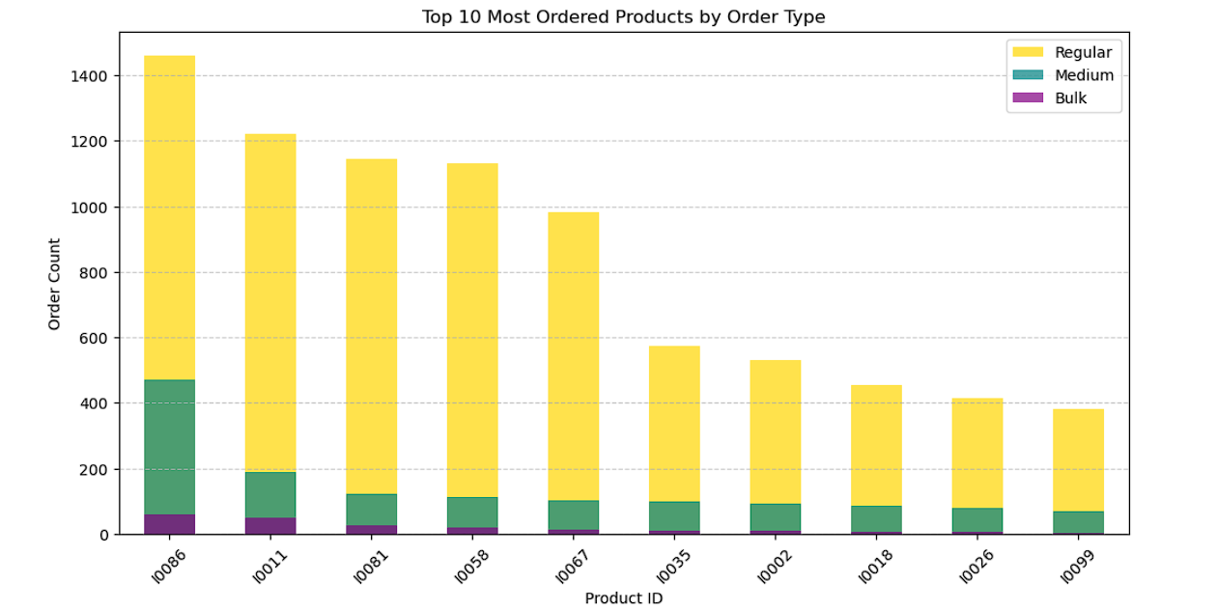
What are the top-selling products?
Regular Orders dominate the majority of product purchases.
Medium Orders and Bulk Orders contribute a smaller but notable portion.
Since Regular Orders dominate, introduce personalized promotions and subscription models to enhance repeat purchases.
Encourage higher-volume purchases through discounted pricing strategies

Slide 10
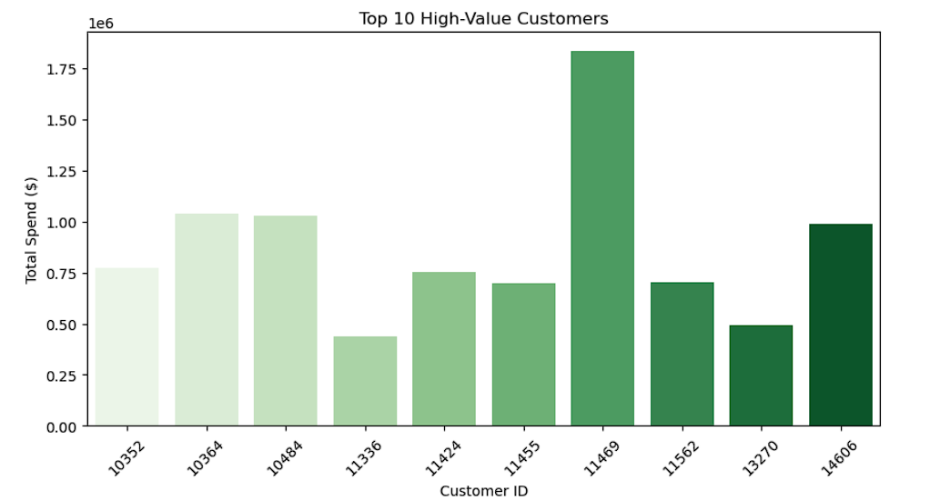
Who are the top customers contributing to revenue?
Customer 11469 leads significantly with the highest total spend, exceeding $1.75 million.
Other high-spending customers, such as 10364, 10484, and 14606, also show substantial purchases.
Develop personalized loyalty programs and exclusive deals for top-spending customers, especially Customer 11469
Offer tiered discounts or premium memberships to encourage continued high spending.

Slide 11
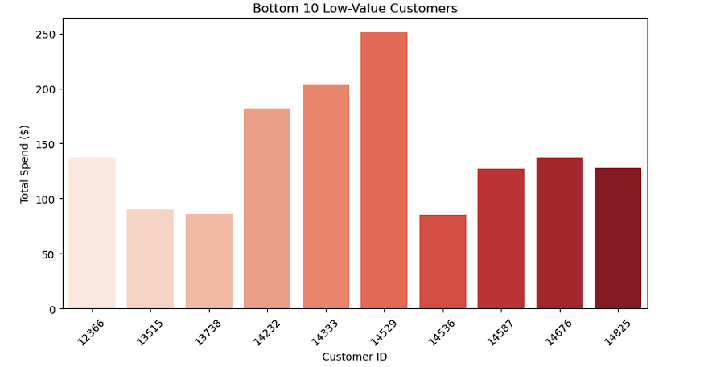
Who are the bottom customers contributing the least to revenue?
The variation in spending suggests opportunities for engagement strategies to increase sales from these customers.
Offer first-time buyer incentives or seasonal discounts to increase purchase frequency.
Use data-driven email campaigns or recommendation engines to showcase relevant products.

Slide 12
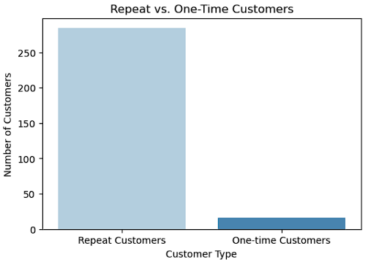
Which customers have stopped ordering?
The majority of customers are repeat buyers, while only a small portion are one-time customers.
This indicates strong customer retention, but there may be opportunities to convert one-time buyers into repeat customers
.
Encourage repeat purchases with subscription offers or loyalty rewards.
Gather insights from one-time customers to identify pain points and improve retention strategies.

Slide 13
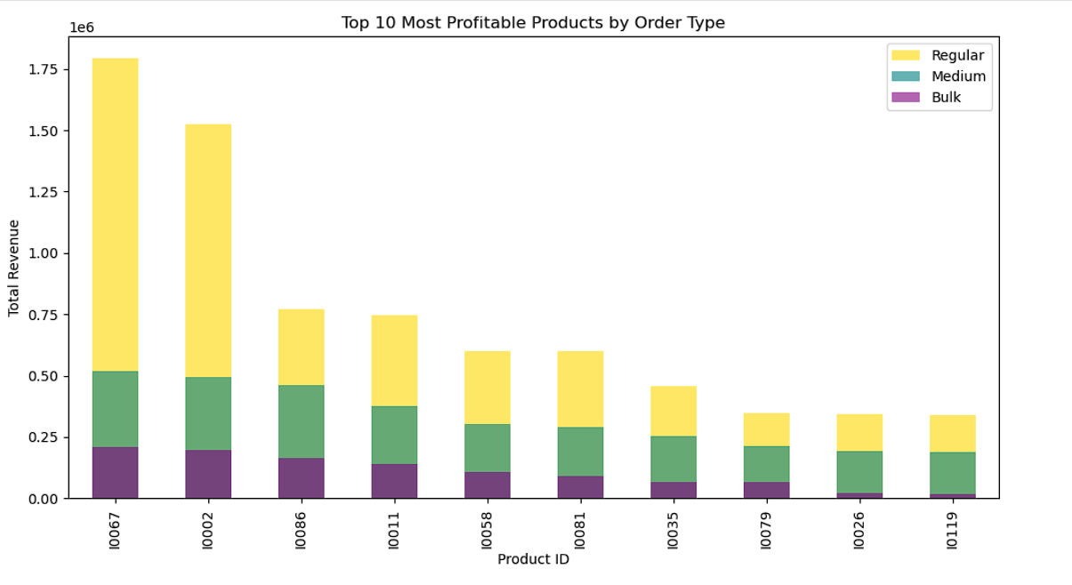
Which products generate the most revenue?
Regular orders generate the highest revenue – Focus on pricing strategies and promotions to maximize profitability.
Medium orders provide stable contribution – Introduce loyalty programs and targeted discounts to encourage repeat purchases.
Bulk orders have growth potential –Implement wholesale pricing tiers and build partnerships to expand sales volume.

Slide 14
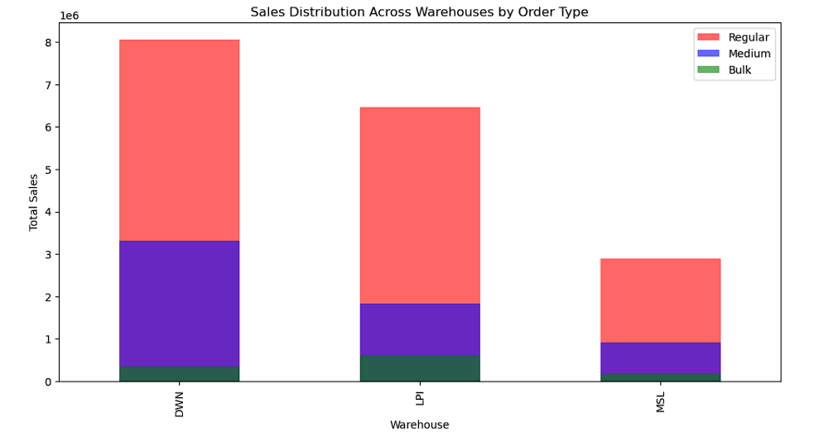
Which warehouse handles the highest volume of orders?
Regular Orders dominate across all warehouses, with Medium Orders contributing moderately and Bulk Orders being the least.
Minimal Bulk Order sales suggest possible constraints in warehouse handling or customer preferences for smaller order sizes.
Investigate whether logistical inefficiencies, product availability, or location disadvantages are limiting MSL’s performance. Adjust operations accordingly. Since DWN leads in sales, consider scaling its capacity to handle even more orders efficiently.

Slide 15
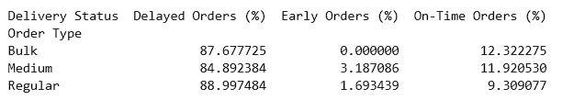
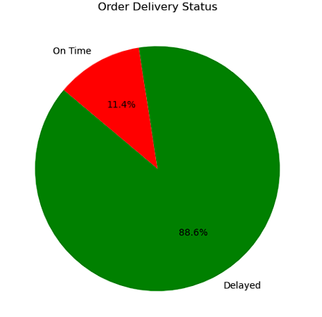
How efficiently are customer orders being fulfilled?
Regular orders have the highest delay rate (88.99%). Identify bottlenecks in inventory management, order processing, and last-mile delivery to improve performance.
The on-time delivery rate is alarmingly low (11.4%). Set realistic delivery SLAs, enhance real-time tracking, and invest in better logistics partnerships.

Slide 16
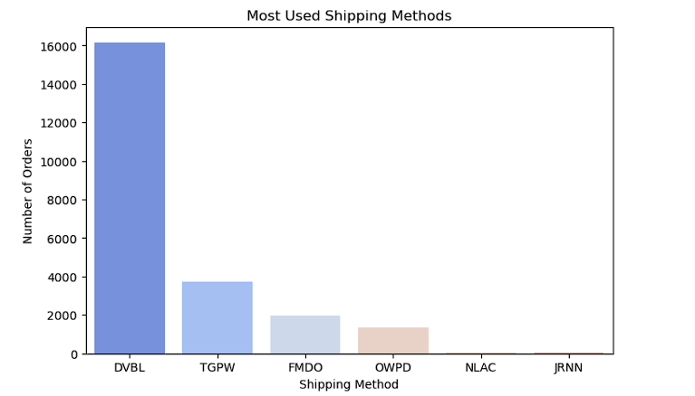
Most Used Shipping method
Optimizing shipping choices can improve cost and efficiency.
Since DVBL handles the majority of shipments, leverage this volume to secure discounts or improved service terms.
Encourage the use of alternative carriers to reduce dependency on a single provider and mitigate risks

Slide 17
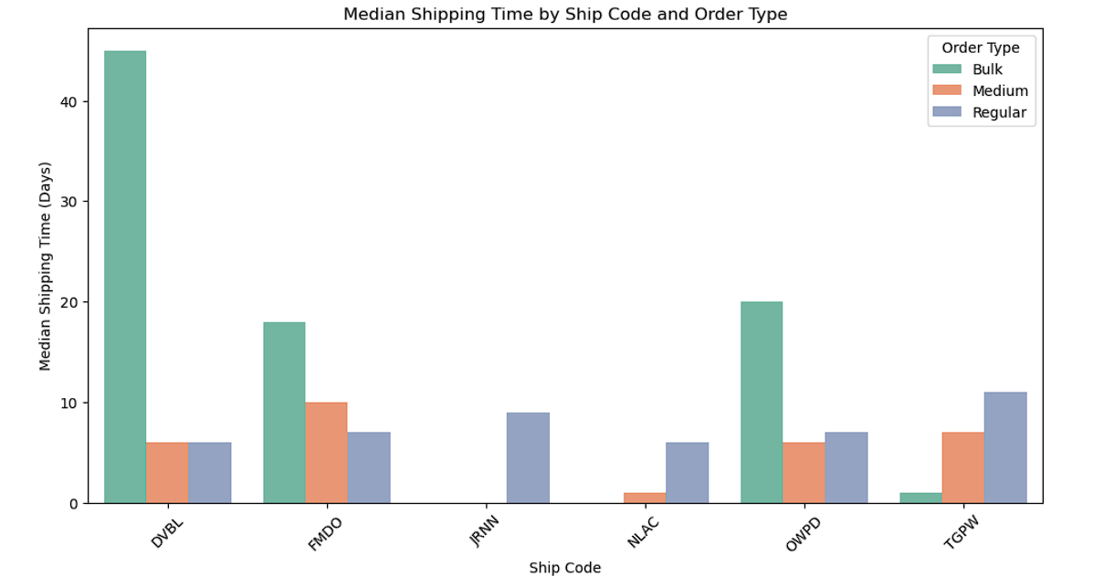
Which warehouses have the highest shipping times?
Bulk orders experience significantly higher median shipping times, especially for DVBL and OWPD.
Regular and Medium orders have lower and more consistent shipping times across ship codes.
DVBL and OWPD face the highest delays—investigate logistics bottlenecks and explore alternative shipping solutions.

Slide 18
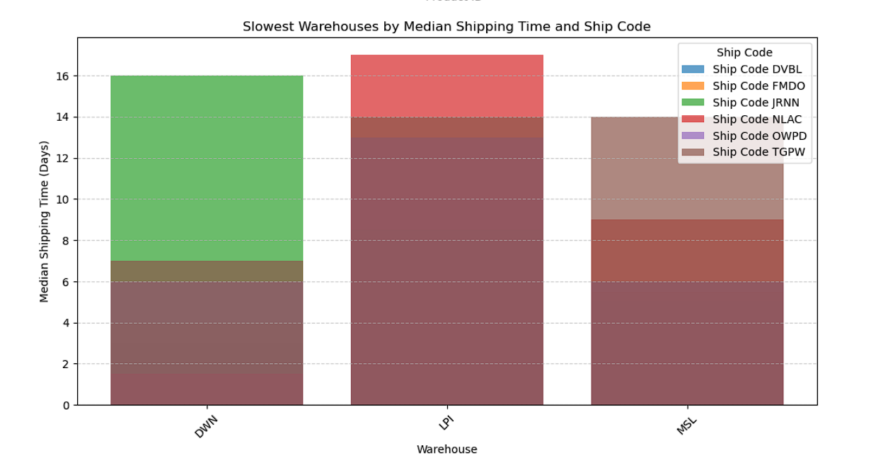
Which warehouses have the slowest median shipping times based on ship codes?
Warehouse LPI has the highest median shipping time, indicating potential delays in processing or logistics.
DWN and MSL also experience significant delays, with different ship codes contributing to overall longer shipping times.
Multiple ship codes contribute to delays, suggesting that inefficiencies are spread across different shipping processes rather than isolated to a single factor.

Slide 19
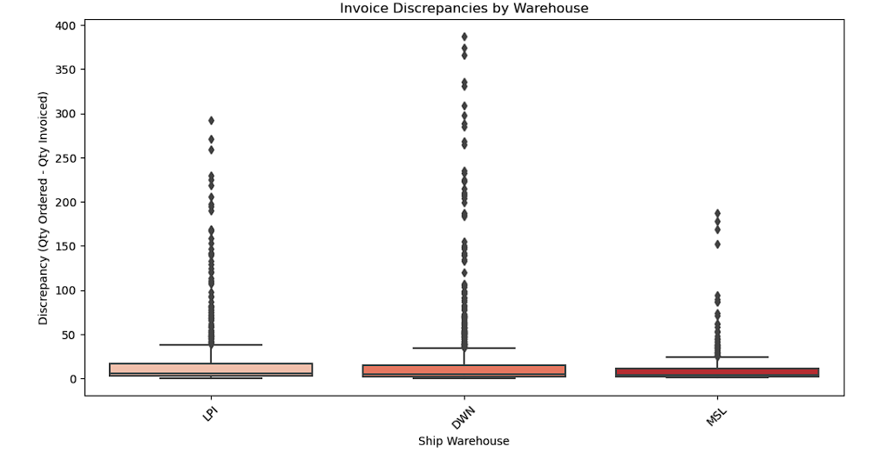
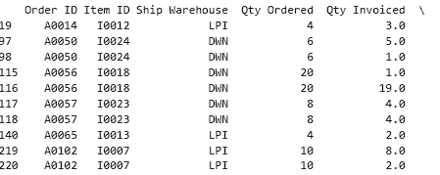
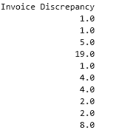
Are there discrepancies between ordered and invoiced quantities?
Significant discrepancies exist between ordered and invoiced quantities across warehouses.
The highest variations are observed in the DWH warehouse, indicating potential process inefficiencies
Since DWH has the highest discrepancies, conduct an in-depth audit of inventory management, invoicing, and order fulfillment processes..

Slide 20
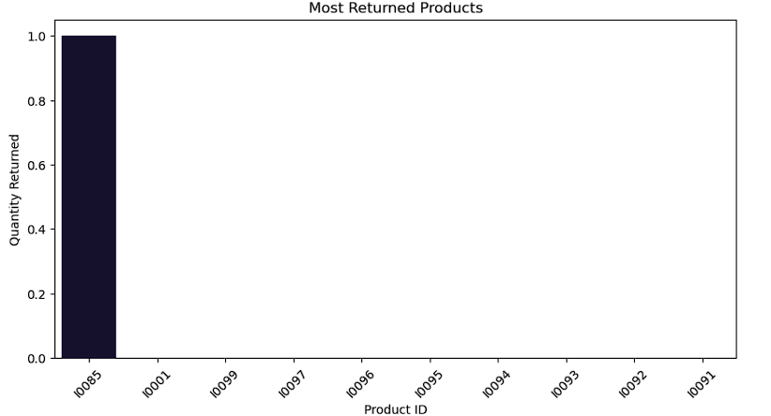
Product Returns
Only Product I0065 has recorded returns.
No other products show significant returns.
This may indicate a specific issue with I0065, such as quality defects, incorrect shipments, or customer dissatisfaction."

Slide 21
Conclusion:
Significant shipping delays are observed in both small (88.99%) and bulk (85.17%) orders, impacting delivery efficiency.
DVBL and OWPD ship codes show the longest shipping times, indicating potential logistical bottlenecks.
Business Recommendations:
Optimize Shipping Routes → Investigate DVBL & OWPD delays, explore alternative carriers, and improve route planning.
Enhance Order Processing → Streamline warehouse operations and implement predictive demand forecasting.
Implement Real-time Tracking → Use AI-driven tracking systems to monitor shipments and reduce delays.

Slide 22
GitHub

